Slide 1
Central Europe: imagined or real?
György Csepeli
ELTE, iASK

Slide 2
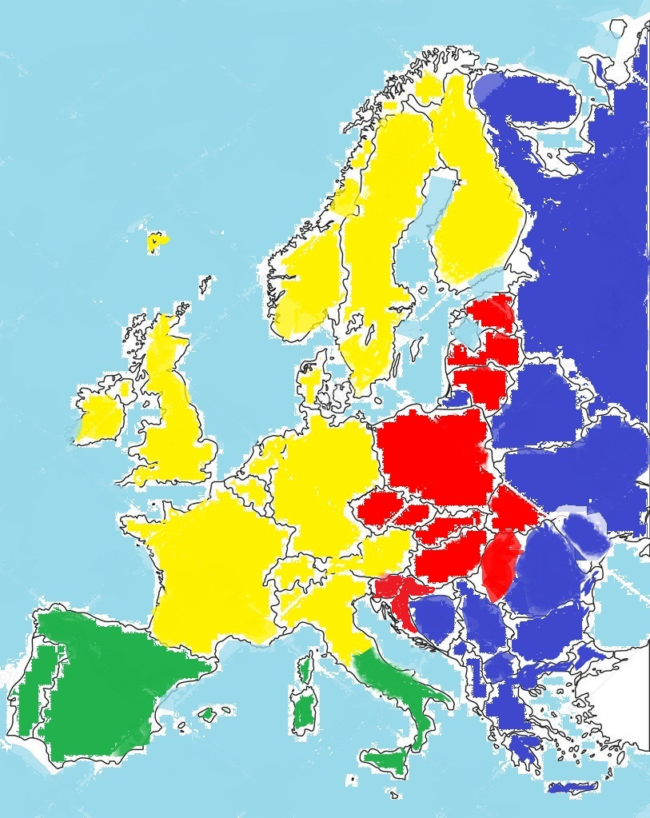

Slide 3
Does Central Europe exist?
Central Europe is synonymous with Mitteleuropa, a concept of Friedrich Neumann conceived during the First World War
Central Europe was born in Habsburg Empire, refers to the Austro-Hungarian Monarchy
Geographically the area between the Baltic and Adriatic Sea
The member states of the „Visegrad four”

Slide 4
Three historical regions of Europe
Split of the Roman Empire
Western Part (Rome)-Occidens
Eastern Part (Byzantium)-Orient
(Jenő Szűcs, Julianna Parti, 1983. The Three Historical Regions of Europe: An Outline. Acta Historica Academiae Scientiarum Hungariacae, vol. 29. No. 2/4. pp. 131-184

Slide 5
Occidens
Carolingian Empire, Western model ( „narrow circles of freedom)
The Eastern Border around 800 AD: the line running southwards across Europe from the lower course of the Elbe-Saale, along the Leitha
( This was exactly the line that divided Europe into two „camps” in 1945. Is as if Stalin, Churchill and Roosevelt have studied the age of Charlemagne befor letting the Iron Curtain to fall

Slide 6
Orient
Byzantinum’s intention was to defend the heritage of Romans against the Barbarians by maintaining a defensive rigidity.
Byzantinum continued Rome’s centralized. bureaucratic state structure, no freedom for indidividuals and their communities
The workings of medieval Europe remained incomplete in this region. The overwhelming majority of this region was to become Russia

Slide 7
Temporary Expansion of the West into East
Between 1000 and
astern Carpathians and further north reaching the Baltic regions. This expanded West included Scandinavia as well
This border can be illustrated by the presence or lack of presence of Romanesque, Gothic and Renessaince buildings

Slide 8
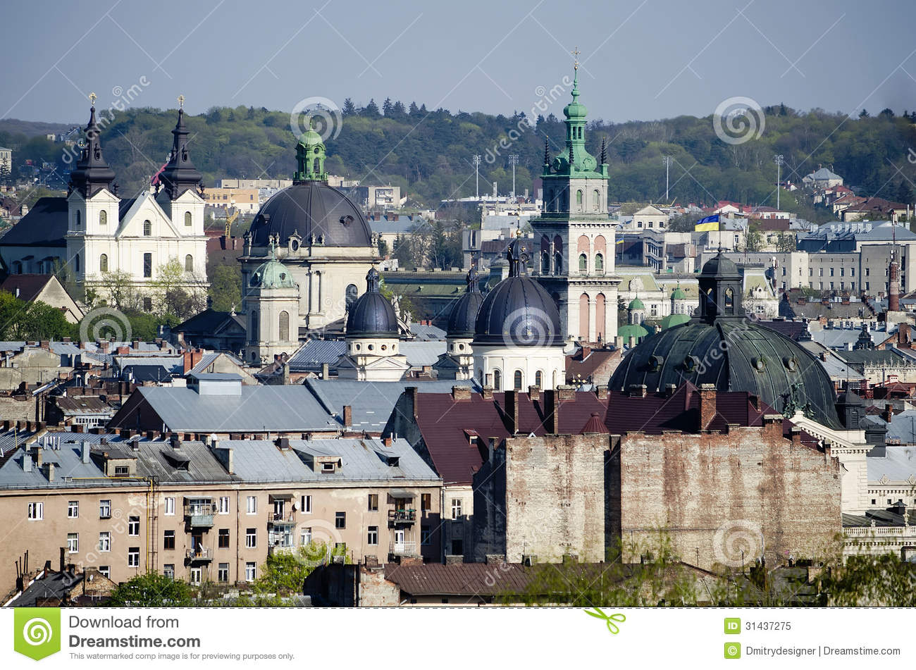
Lviv (border city)

Slide 9
Withdrawal
After 1500 the eastern border of the late Carolingian Empire was to become a border again separating Western and Eastern Europe
Western Europe lost its medieval extension
A new region has emerged inserted between the original Western and Eastern regions of Europe
This area is Central Europe

Slide 10
Structural differences between West and East
West East
From the bottom From the top
Local autonomy Centralizaton
Personal autonomy Authority
Entrepreneurship Bureaucratic career
Civic society State
Civic rights Privileges
Urbanization State settlements
Industralization Agrarian society
Perpetual growth Stop and go

Slide 11
Two cultures
Culture of credit Culture of levy
Trust Distrust
Pride Complain
Tax Tax evasion
Empathy Envy
Pro-capitalism Anti-capitalism
Citizen Subject
Rule of law Autorithy makes law

Slide 12
Central Europe
Mix of the two structures
Mix of the two cultures
Dualisms (coexistence of feudal and capitalist segments of the society)
The clash of traditionalism and modernity
„Alienization” of modernity (Anti-Semitism)
Self-orientalization of „traditionalism”
Lack of sovereignity, legacy of imperial repression

Slide 13
Three clusters of Europeans (2008)
Secondary analysis of the results of the European Social Survey
Active, autonomous, citizens (38 %) (black)
Passive, submissive, subjects (37 %)
Rebels (25 %)

Slide 14
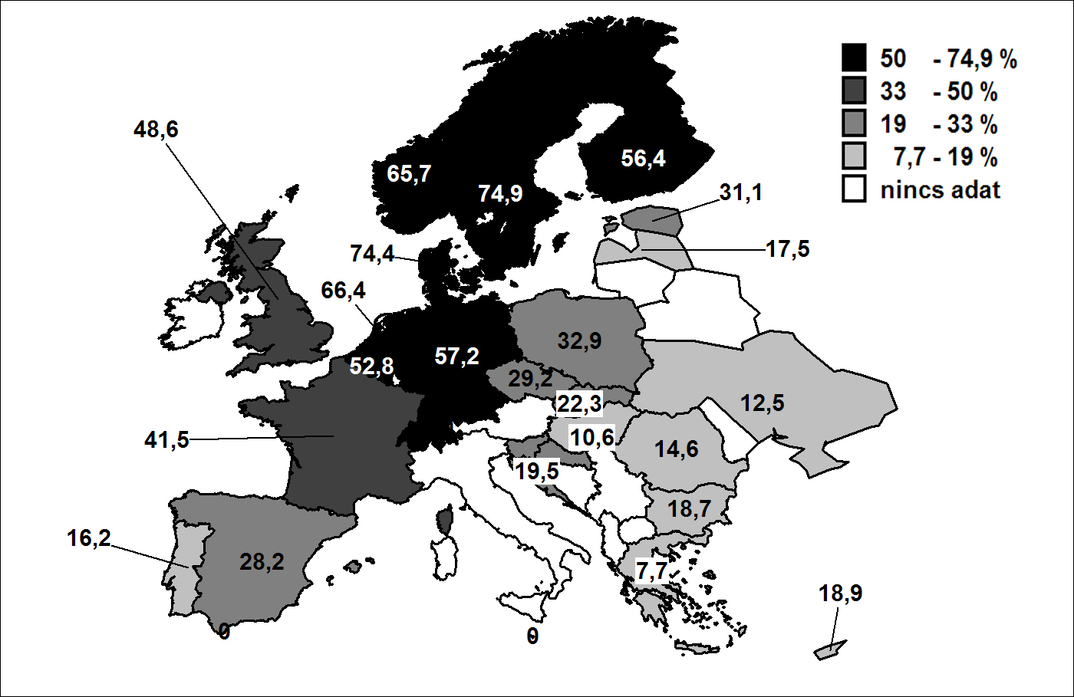
The persistence of the past

Slide 15
Future scenarios
Exclusion from Western Europe (isolation)
Inclusion into Western Europe (shared crisis)
Bridgeing between East and West

